Slide 1
Implmentation Update
By Grace Xu

Slide 2
OwlV2 + Ruptures

Slide 3
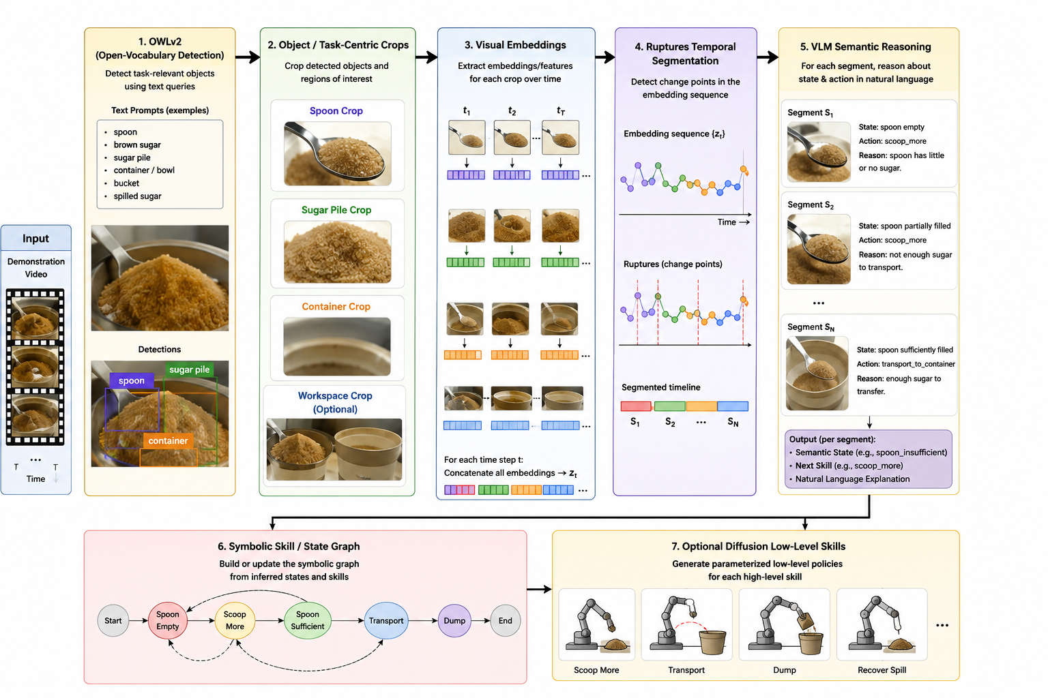
Updated Implementation

Slide 4
Credit: template was created by Slidesgo
Thanks!

